Slide 1
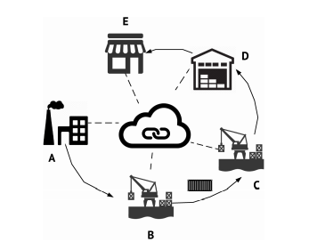
Project Presentation on
IOT BASED AIR QUALITY MONITORING SYSTEM and BLOCKCHAIN SOLUTION

Slide 2
ABSTRACT
When air get mixed with harmful gases and substances it is called air pollution.
Mainly three types of air pollutants has been considered namely green house gases (CO2, CH4, O3, CO), acid rain (NOx and SO2) and particulate matter (PM2.5 and PM10).
The sources of pollutants are industrial emission, hazardous emissions form vechicles,burning of fossil fuels etc.
Pollutant air can causes severe health effects such as heart disease, lungs cancer, respiratory infections etc.

Slide 3
INTRODUCTION
This project is aimed to develop an IOT based application to deal with air pollution
With the help of sensors such as MQ135 various air parameters are sensed and transmitted.
We used Raspberry Pi because it has built in Wi-Fi and allows us to connect our system to the internet with an ease.
The prototype connects with Wi-Fi and uploads all air parameters to centralized server.
Encryption of data was done in the server database using block-chain technology and libraries like Hash library.

Slide 4
EXISTING SYSTEM
To collect parameters many electro mechanical devices are used.
These devices are heavy and not economical to install at many places.
Periodical collection of data is difficult
Still manual intervention is required for collecting and feeding data to central servers.
Data is not secured. It can be hacked or tempered.

Slide 5
PROPOSED SYSTEM
Since its IOT based product all functional units are connected in a network.
All things such as sensors base station,cetralized server work together by means of communication over network.
Data collected from sensors gets uploaded to cloud servers instantly and it is encrypted using block-chain technology.
For authorities such as pollution control board, data is easily available and secure.
They can draw conclusions and take actions instantly.

Slide 6
HARDWARE REQUIREMENTS
Raspberry Pi
Memory Card – 32 GB or higher.
1 MQ 135 sensor for CO2 measurement
Resistors ( 1k, 2k ohm)
Bread board
Jumper wires.

Slide 7
SOFTWARE REQUIREMENTS
Knowledge of Block-Chain Technology
Knowledge of Programming Language (Python)
App Development
Cloud Server
Cloud Database

Slide 8
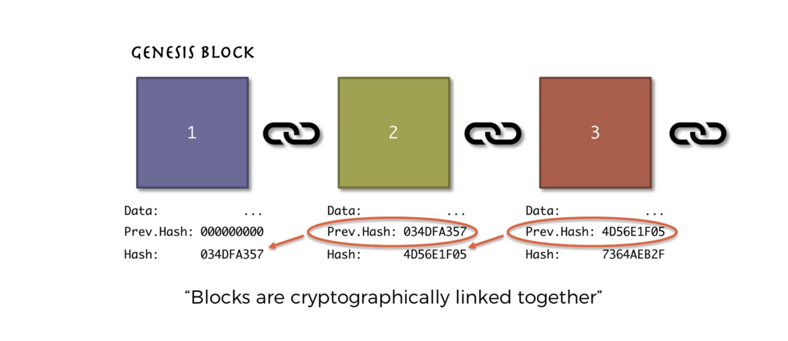
What is a Blockchain:
A blockchain is a continuously growing list of records, called blocks, which are linked and secured using cryptography.

Slide 9
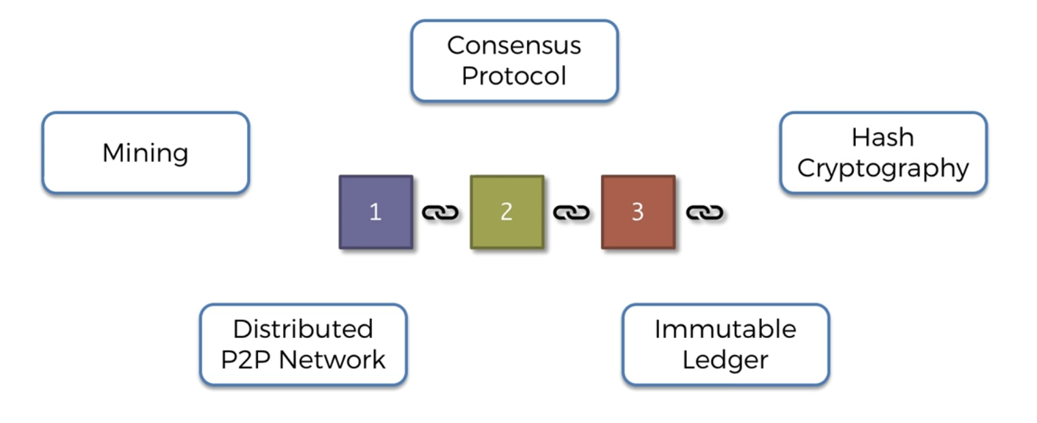
.
Fig: key elements of a blockchain.

Slide 10
SYSTEM DESIGN

Slide 11
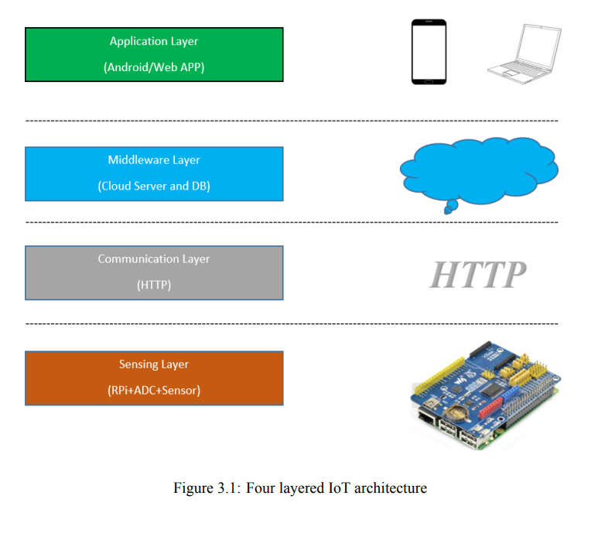
ARCHITECTURE DIAGRAM

Slide 12
DATA FLOW DIAGRAM
1. Fetch gas content form AIR using MQ135 sensor
2. Process the data using Libraries
3. Establish connection with server using Wi-Fi
4. Upload to database using server script and perform encryption using Block-chain technology (using libraries like HASH lib and SHA256 algorithm)
Data table
4. Repeat from step1 with delay

Slide 13
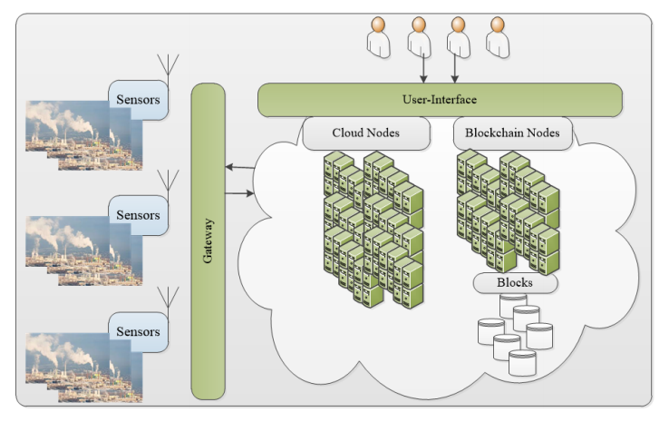
Implementation of Blockchain

Slide 14
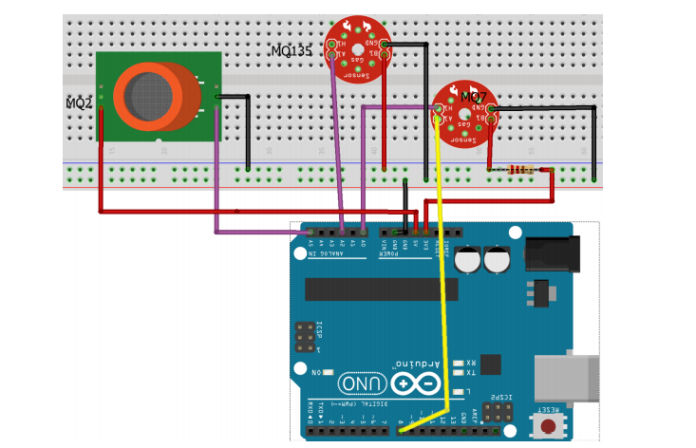
Circuit DIAGRAM
Fig: Circuit Diagram for sensing Air Quality Parameters such as CO, CO2 and Smoke particles

Slide 15
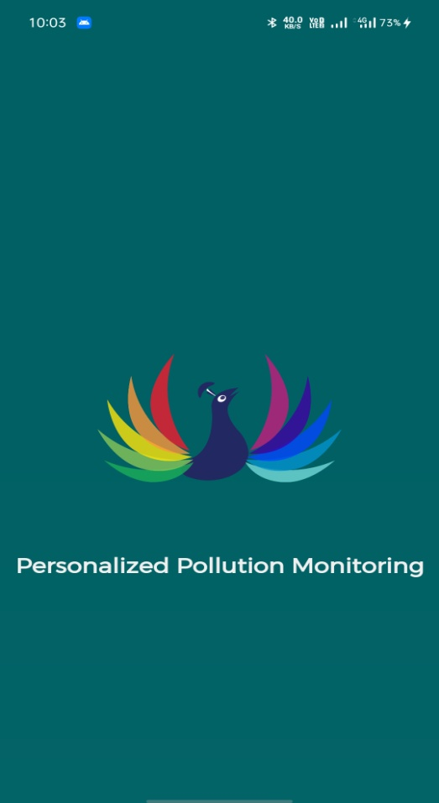
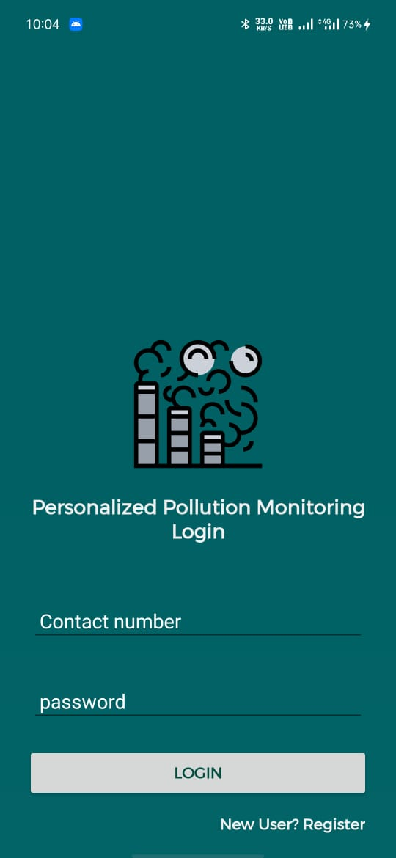
User Interface Part: Mobile Application
Fig: Showing Login Page of our mobile App

Slide 16
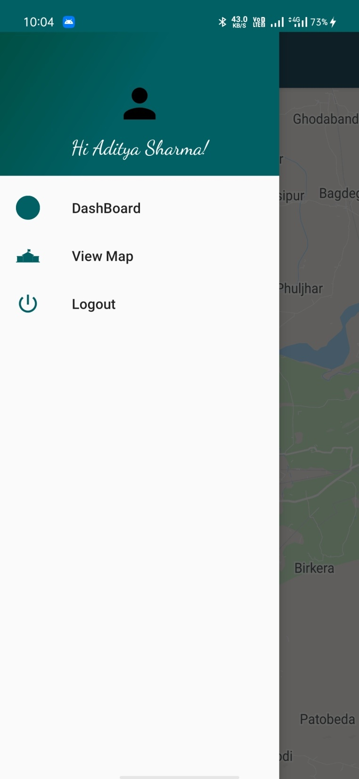
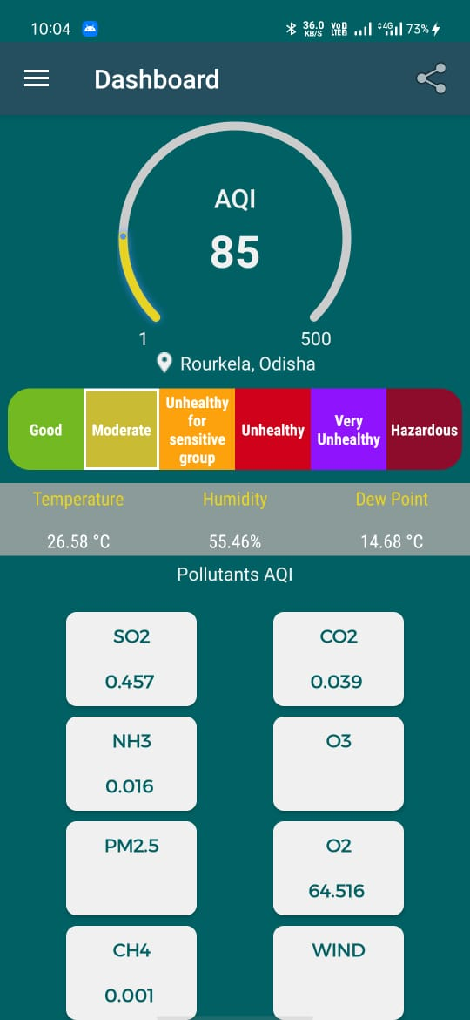
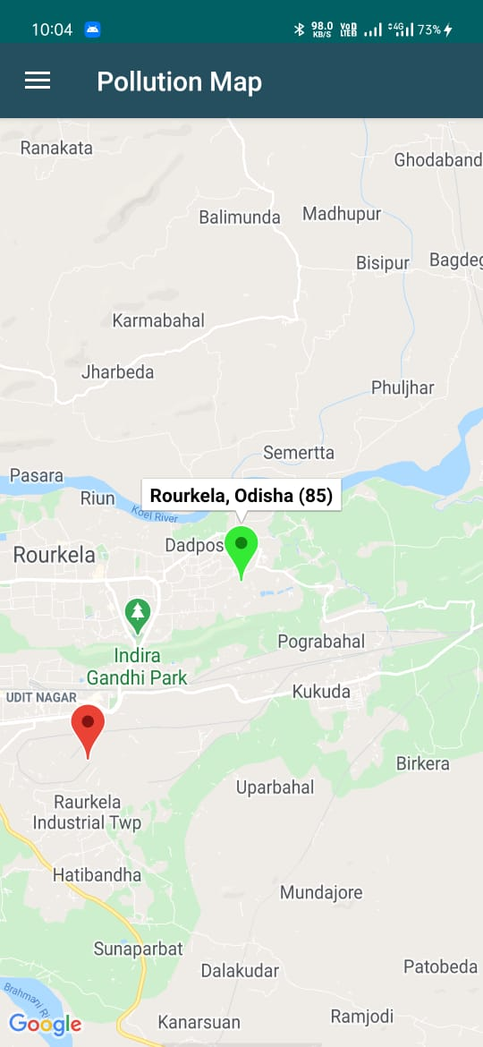
Mobile Application

Slide 17
CONCLUSION
Monitoring the environmental parameters especially with respect air plays very important role to ensure healthy environment for living beings. We have seen various hazards being caused at Delhi due to air pollution. There are many reasons for causing air pollution but knowing their concentration at various locations helps to take decisions on prevention measures.
The proposed application works on the principle of IOT, data read from sensor are processed by the processor then uploaded to database, these data are analyzed and displayed to users, and user could fetch this information over phone or webserver and take proper action to prevent pollution.

Slide 18
FUTURE ENHACEMENTS
It can be improved further by adding more sensors to existing system like dust particles sensors and etc.
2. Interface GPS module to screen the contamination at precise area and transfer on the website page for the netizens.

Slide 19
References
[1] AirQuality dataset, https://data.gov.in/catalog/air-quality-residential-areas-under-national-ambient-air-quality-monitoring-programme-few 2019.
[2] AlMasri, Eyhab Diabate, Ibrahim Jain, Richa Hoi Lam Lam, Ming Reddy Nathala, Swetha. (2018). A Serverless IoT Architecture for Smart Waste Management Systems. 179-180. 10.1109/ICII.2018.00034.
[3] Air Quality Indexing software, https://waqi.info/, 2019.
[4] Benedict S., Revenue oriented air quality prediction microservices for smart cities, in IEEE 2017 International Conference on Advances in Computing, Communications and Informatics (ICACCI), Udupi, pp. 1-6, doi: 10.1109/ICACCI.2017.8125879.
[5] Bharadwaj B, M. Kumudha, Gowri Chandra N and Chaithra G, "Automation of Smart waste management using IoT to support “Swachh Bharat Abhiyan” - a practical approach," 2017 2nd International Conference on Computing and Communications Technologies (ICCCT), Chennai, 2017, pp. 318-320. doi: 10.1109/ICCCT2.2017.7972300
[6] Leo Breiman, Random Forests, in Machine Learning, Vol. 45, No.1, pp. 5-32, 2001.
[7] Cai, C.-J., X. Zhang, K. Wang, Y. Zhang, L.-T. Wang, Q. Zhang, F.-K. Duan, K.-B. He, and S.-C. Yu, Incorporation of New Particle Formation and Early Growth treatments into WRF/Chem: Model Improvement, Evaluation, and Impacts of Anthropogenic Aerosols over East Asia, Atmospheric Environment, Vol.124, pp.262-284, 2016.
[8] Giffinger R., Fertner C., Kramar H., Kalasek R., Pichler-Milanovic N., Meijers E., Smart cities: Ranking of ´ European medium-sized cities, http://www.smart-cities.eu/download/smart_cities_final_report. pdf, 2007.
[9 ] Gubbi, J., Buyya, R., Marusic, S., & Palaniswami, M. (2013). Internet of Things (IoT): A vision, architectural elements, and future directions. Future Generation Computer Systems, 29(7), 1645-1660. doi:10.1016/j.future.2013.01.010.
[10] P. Haribabu, S. R. Kassa, J. Nagaraju, R. Karthik, N. Shirisha and M. Anila, "Implementation of an smart waste management system using IoT," 2017 International Conference on Intelligent Sustainable Systems (ICISS), Palladam, 2017, pp. 1155-1156. doi: 10.1109/ISS1.2017.8389367
[11] Hori, M., Ono, S., Miyashita, K., Kobayashi, S., Miyahara, H., Kita, T., . . . Yamaji, K. (2018). Learning System based on Decentralized Learning Model using Blockchain and SNS. Proceedings of the 10th International Conference on Computer Supported Education. doi:10.5220/0006666901830190.
[12] A. Kadri, E. Yaacoub, M. Mushtaha, and A. Abu-Dayya, Wireless sensor network for real-time air pollution monitoring, in Proc. of IEEE Int. Conf. on Commn., Signal Proc. and their Appln, pp. 1 - 5, 2013.
[13] Lake, D., Milito, R., Morrow, M., & Vargheese, R. (2014). Internet of Things: Architectural Framework for eHealth Security. Journal of ICT Standardization, 1(3), 301-328. doi:10.13052/jicts2245-800x.133.

Slide 20
THANK YOU

